Slide 1
Ready 2026: ADA Compliance
What You Need to Know
Notes:
Updated 1.13.26

Slide 2

New Legal Requirement
Drew
Americans with Disabilities Act (ADA), Title II
By April 24 - all UT San Antonio digital platforms and documents must comply with accessibility standards. This applies to every employee.

Slide 3
What Digital Content Does This Cover?
Drew
Word, Excel, PowerPoint, PDFs
Web pages
Course Materials
Online forms
Emails, newsletters, announcements
SharePoint or Teams sites
Intranet pages, file libraries
Training materials, meeting slides, reports
Digital signage, flyers, event promotions
Videos
Webinars
Recorded presentations
Recorded ceremonies
Templates and branded materials
Social media content and digital outreach posts shared on official university accounts
Any externally shared digital resources provided to community partners

Slide 4

What If We Miss The Deadline?
Drew
UT San Antonio may face potential financial penalties, while your team may face business interruptions and court mandated changes to content.

Slide 5
What Can You Do?
Ernest
ACTION STEPS
Notes:
Strive for Substantial Conformance - means that your content doesn't have critical accessibility barriers preventing users with disabilities from accessing it. While minor issues may still exist, they should not create significant obstacles for users.

Slide 6


Follow These Steps
Ernest
In Process
Review what accessibility features are missing
Add the features
Make accessibility checks part of your regular process
Review your existing content
Remove outdated content
Revise what’s staying
Realign by creating accessible materials from the start
Legacy Content

Slide 7
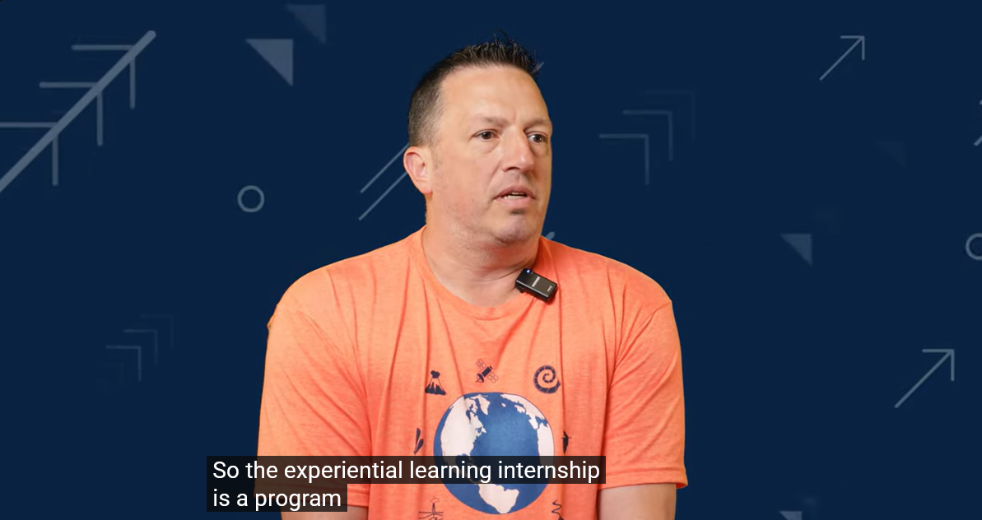
Captioning
Ernest
Required
Must be 99% accurate
Must be synced
Maximum two lines of copy
Maximum 37 characters per line

Slide 8
Captioning Demo (3Play Media)
Ernest
How to update captions so it will start recognizing names (Cheat Sheet)

Slide 9
Captions Style Guidelines
Mitzi
Font: Sans-serif (e.g., Arial, Helvetica) for readability; avoid all-caps
Color: White text on semi-transparent black or brand blue (#032044) background
Logical Breaks: Break lines at natural points (commas, periods); don’t split names or titles
Position: Bottom-center of video; move to top only if lower third is obstructed
Static Text: Keep captions in one position; display long enough to read (≈3 words/sec). Avoid scrolling or flashing
Safe Margins: Keep text within the Title Safe Area (usually the inner 80% of the screen). If text is too close to the edge, it may be cut off by app UI (like the TikTok "Like" button).
Size: Relative to the resolution of your sequence

Slide 10
Font Sizes
Mitzi
Resolution | Minimum for Accessibility | Large / "Social"
1080p (1920x1080) | 58 – 68 px | 80 – 115 px
4K (3840x2160) | 116 – 135 px | 160 – 230 px
Notes:
Netflix requires captions to be "relative to the video resolution," focusing on the ability to fit exactly 42 characters across the screen.
BBC – 8% Rule - A single line of text should be approximately 8% of the player height.

Slide 11
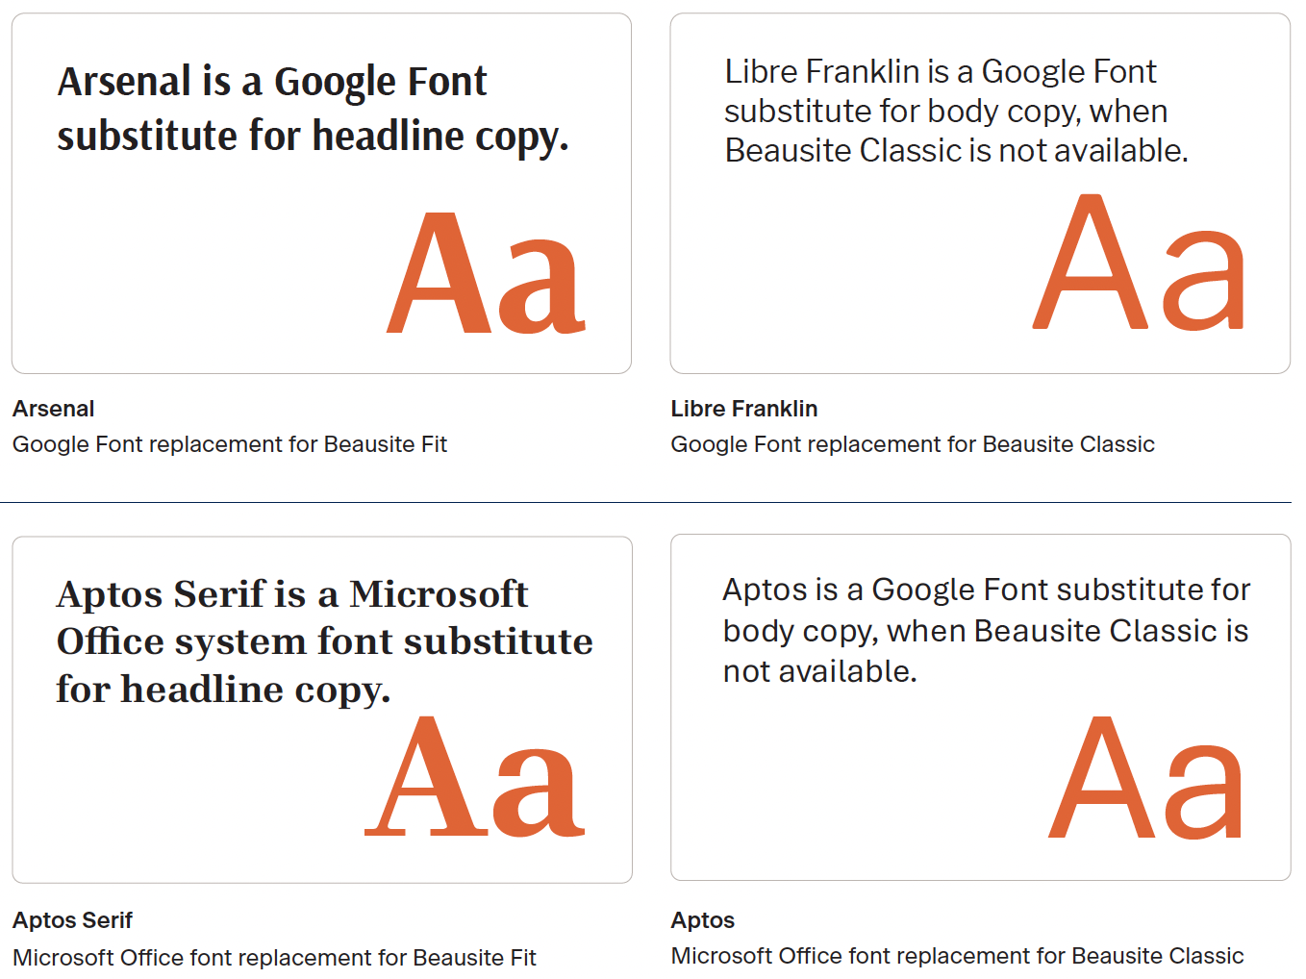
Brand Fonts for Video Graphics
Mitzi
Standard Text:
Beausite Classic (preferred), Aptos, Libre Franklin
Large Graphics (Optional):
Beausite Fit or Arsenal for visual interest
Ensure readability and contrast compliance
Use only for short headlines or hero graphics—not captions or body text
Should meet WCAG contrast ratios (≥ 4.5:1 normal text; ≥ 3:1 large text)
Use sparingly; keep sans-serif fonts dominant
Avoid overly condensed or stylized weights
Notes:
four point five to one, three to one

Slide 12
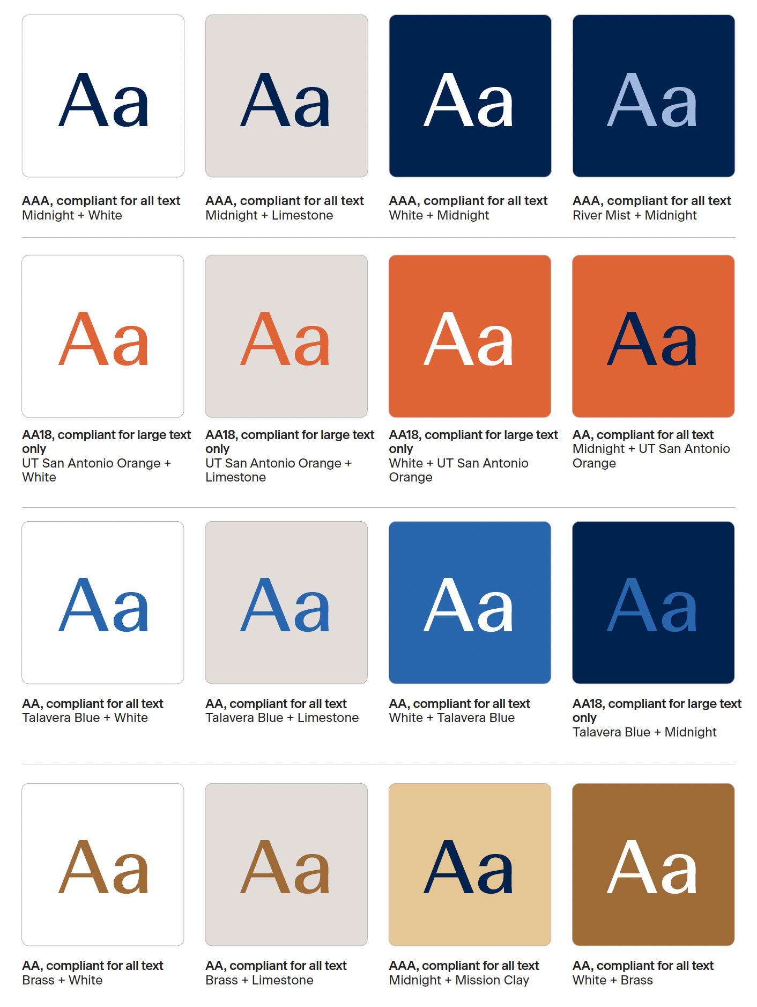
Color Contrast
Mitzi
WCAG recommends minimum contrast ratio of 4.5:1 for text and graphics.
Large-scale text and images of large-scale text must have a contrast ratio of at least 3:1
Text with no contrast requirements
Purely decorative text
Text that is part of a picture containing significant other visual content
Text that is part of a logo or brand name
Notes:
The intent is to provide enough contrast between text and its background, so that it can be read by people with moderately low vision or impaired contrast perception, without the use of contrast-enhancing assistive technology. Talk about orange on video

Slide 13
Resources
Mitzi
Brand Color Palette and Accessible Color Pairings
Contrast Checker
German Federation of the blind and Partially Sighted Font Size Calculator
Options from our website

Slide 14
Quick Checklist
Mitzi
CAPTIONS
99% accuracy
Maximum 32 characters per line
1–2 lines max
Synced with audio
Clean sans-serif font
Size: 80 - 115px for 1080p
White text on semi-transparent black or Midnight blue (#032044)
Positioned at bottom-center
No overlap with lower thirds or graphics
Include speaker IDs
Meaningful non-speech cues added
OTHER ON-SCREEN GRAPHICS
Use brand fonts: Beausite Classic, Aptos, Libre Franklin, Beausite Fit, Arsenal
Beausite Fit or Arsenal only for short headlines or hero graphics
Follow WCAG contrast ratios:
Normal text: ≥4.5:1
Large text: ≥3:1
Sans-serif fonts should dominate

Slide 15
Captioning Demo (Premiere)
Joshua
How to fix captions
How to style captions
How to update captions so it will start recognizing names (Dictionary)

Slide 16
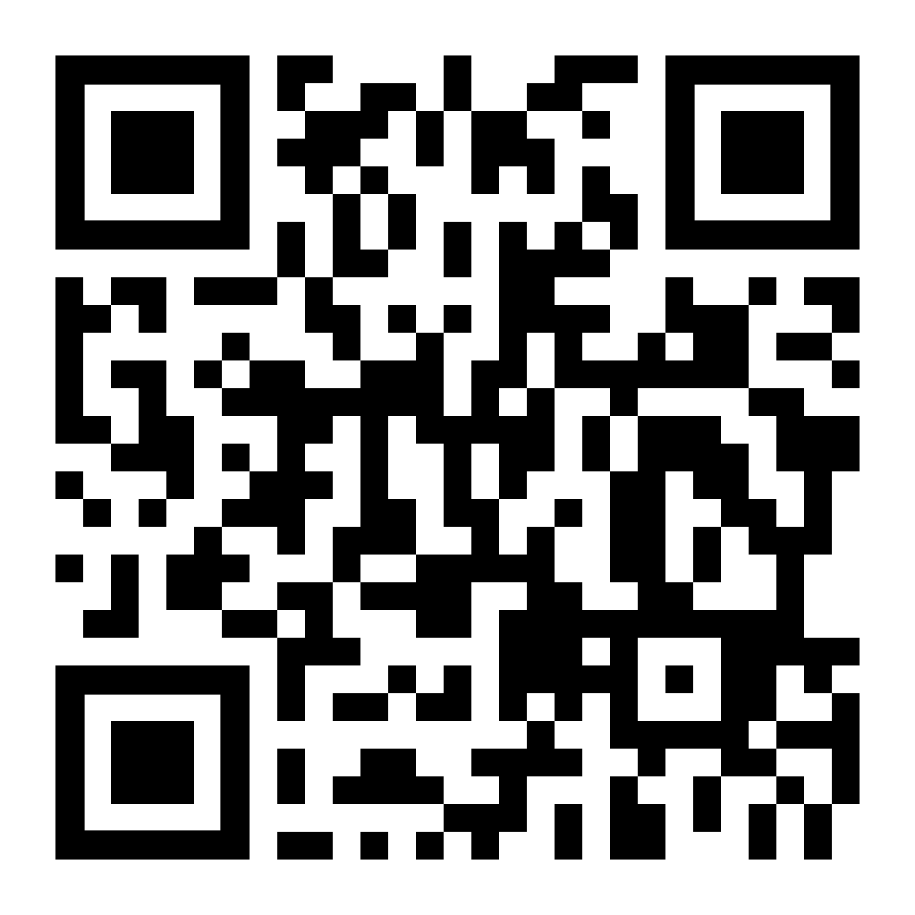
Compliance Takes Time
Ernest
Start today to meet the April 24 deadline
The university’s ADA team has developed detailed pre-built plans, trainings, tools, and more broken down by the programs and materials that you use every day
Scan the code or visit
www.utsa.edu/ada/compliance2026/

Slide 17
Learn more about accessible video:
Mitzi
W3C WAI: Captions/Subtitles
W3C WAI: Making Audio & Video Media Accessible
WCAG 1.4.3: Contrast (Minimum)
Section508.gov: Captions & Transcripts
Columbia University: Creating Accessible Video
WCAG Technique G87: Providing Closed Captions
The "8% Rule" (BBC Guidelines)
Relative Resolution (Netflix Style Guide)
3PlayMedia Best Practices for Caption Formatting Rules for text in videos

Slide 18
End Slide

